Slide 1
End Term Examination
Front End Engineering
Submitted to – Mr Rafeeq
Submitted by – Gurbakshish Singh
2010990851
G - 11

Slide 2
CONTENT
1.Acknowlegdement
2.Abstraction
3.Introduction
4.Pages
4.1.Home
4.2.About
4.3.Details
4.4.Contact Us
4.5.Upload Image
5.Conclusion
6.Bibliography

Slide 3
Acknowledgement
First and foremost, we would like to thank our Teacher Mr.Rafeeq who
guided us in doing this project. He provided us with invaluable advice. His
motivation and help contributed tremendously to the successful completion of
the project.
Besides, thanks to all who helped in giving all the advice and
providing the equipment which was needed.
Also, we would like to thank our family members and friends for their support.
Without their support, we couldn’t have succeeded in completing this project.

Slide 4
Abstract
This project on the website of “The Garnet Society” is useful for easy user interface. The project help to store data, data retrieval and data manipulation. This project provides more ease for managing the data than manually maintaining in the documents. The project is useful for saving valuable time and reduces the huge paper work. It will help educational Institutions like schools and colleges will keep track of their student records like personal details ,contact details,image details , etc

Slide 5
Introduction
React is a declarative, efficient, and flexible JavaScript library for building user interfaces.
React uses a declarative paradigm that makes it easier to reason about your application and aims to be both efficient and flexible. It designs simple views for each state in your application, and React will efficiently update and render just the right component when your data changes. The declarative view makes your code more predictable and easier to debug.
React creates a VIRTUAL DOM in memory.
Instead of manipulating the browser's DOM directly, React creates a virtual DOM in memory, where it does all the necessary manipulating, before making the changes in the browser DOM.

Slide 6

Conclusion
ReactJS is one of the highly used open-source JavaScript Library that helps in creating impressive web apps requiring minimal effort and coding. The key objective of ReactJS is also developing engaging User Interfaces (UI) that improves the speed of the apps.
One of the prominent factors that go in the favor of ReactJS is that it is launched by none other than the social media king Facebook. Moreover, ReactJS can render on the server using Node. The developers can also look to build native apps by employing the React Native.
React is providing the developer’s a better work experience and the advantage to change any component at any point in time without affecting the rest of the applications, resulting in widespread business support and innumerous websites built on React.

Slide 7

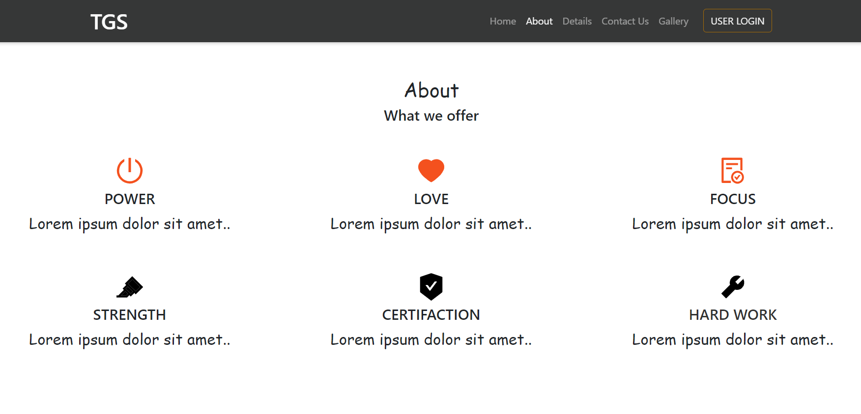

Slide 8
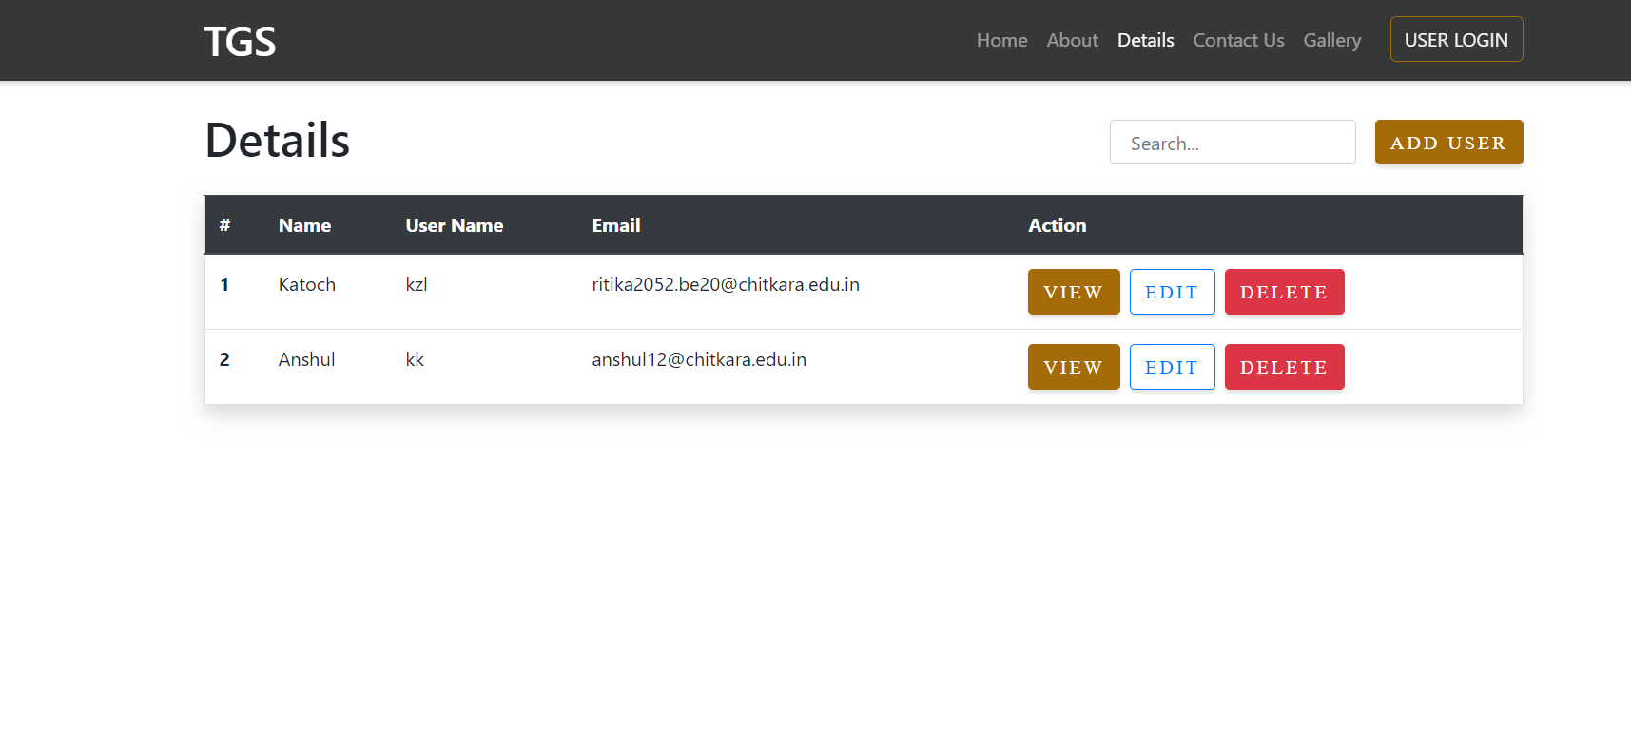
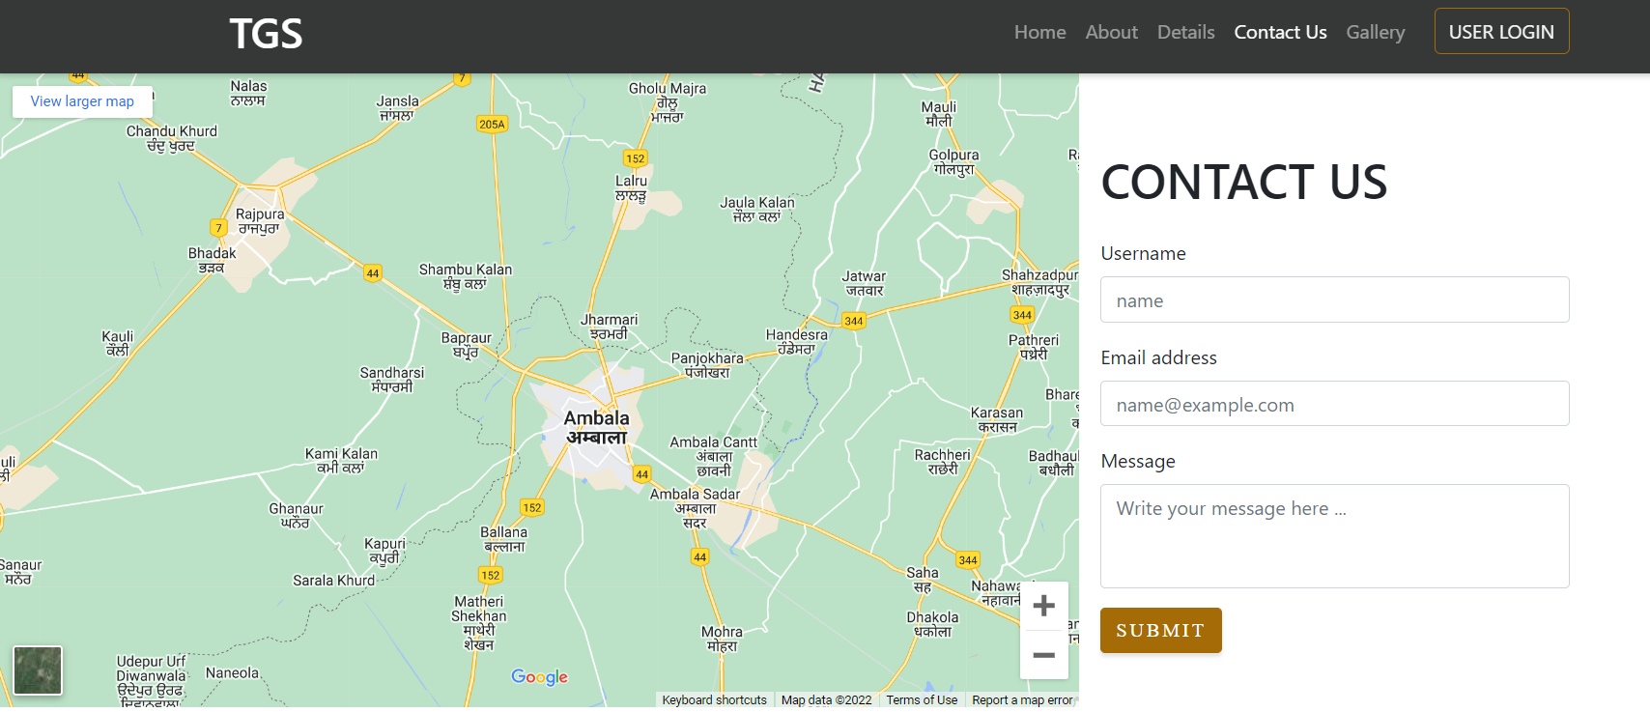

Slide 9
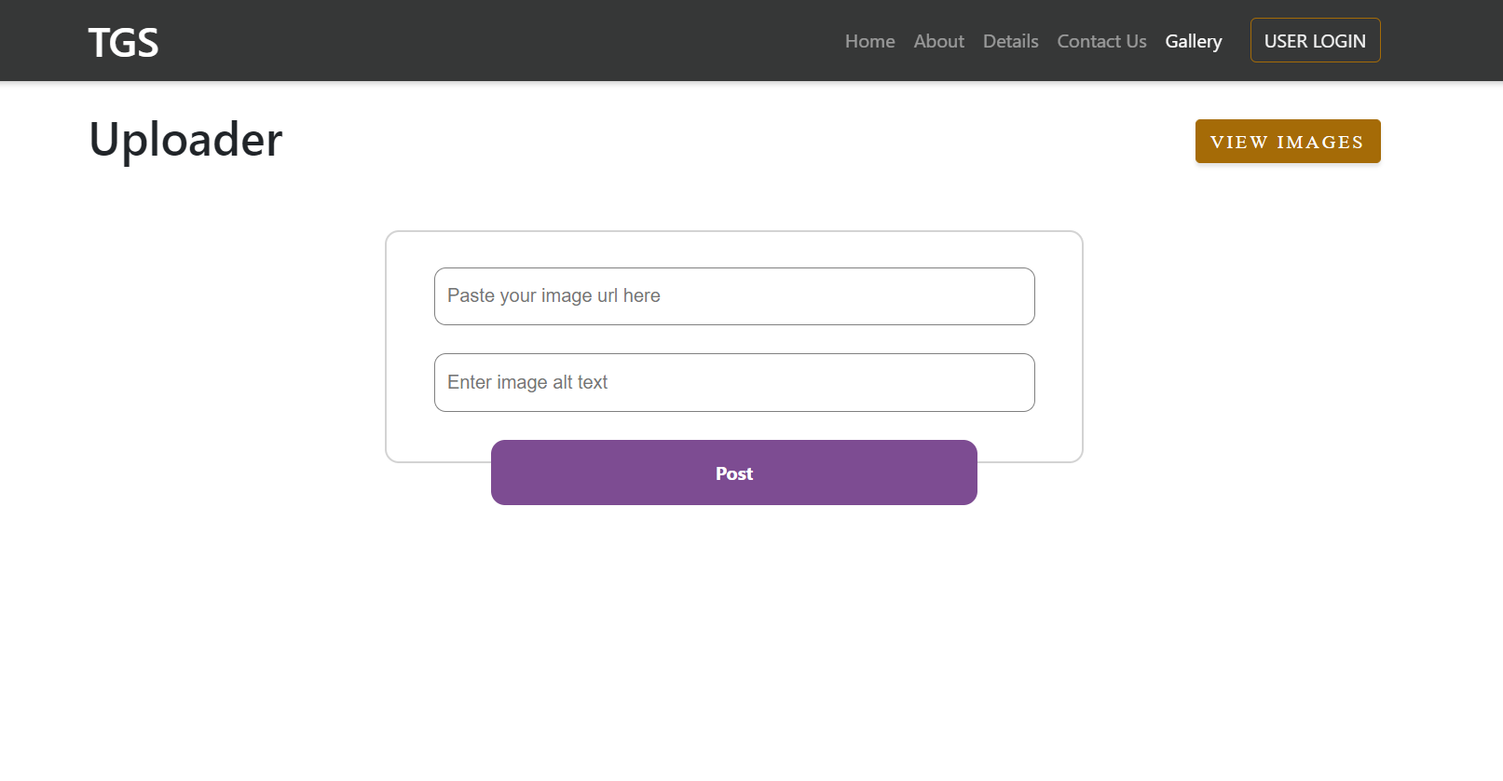


Slide 10
Bibliography
https://www.geeksforgeeks.org/reactjs-tutorials/
https://www.w3schools.com/REACT/DEFAULT.ASP
https://reactjs.org/
https://en.wikipedia.org/wiki/React_(JavaScript_library)

